Slide 1
STABILIZATION OF THE VARIABLE-HEIGHT INVERTED PENDULUM BASED ON INPUT-TO-STATE STABILITY AND SLIDING MODE CONTROL UNDER UNILATERAL CONTACT AND INPUT SATURATION
BACHELOR THESIS
GABRIEL ENRIQUE GARCÍA CHÁVEZ
LIMA-PERÚ
2018

Slide 2
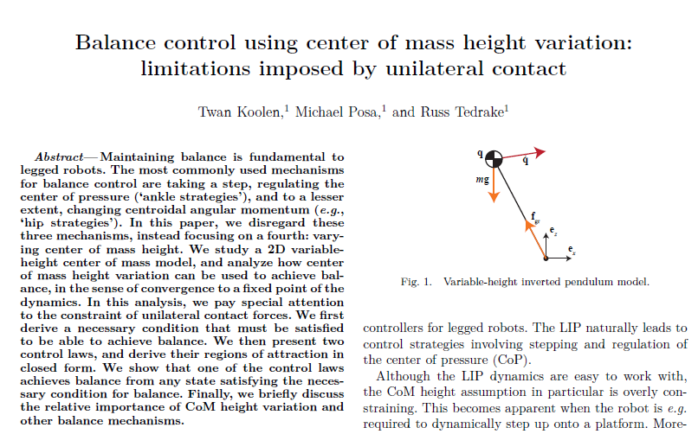

Slide 3
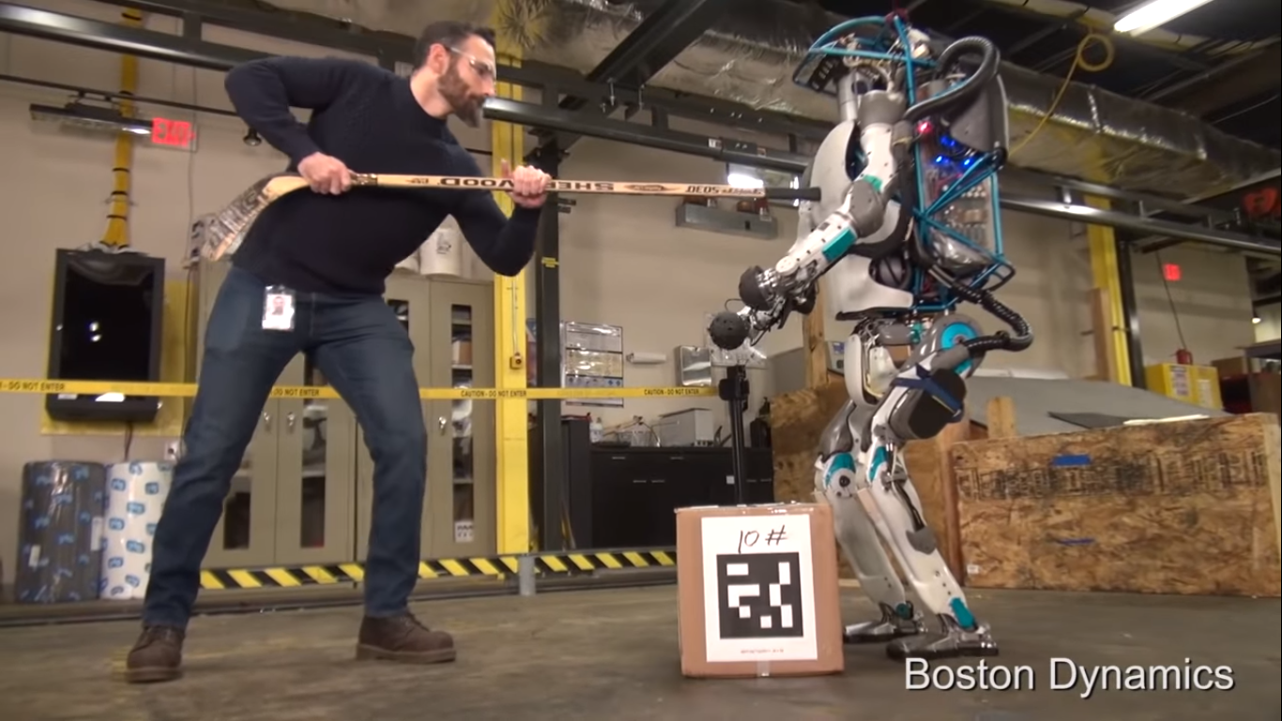
CHAPTER I:
1.2. PROBLEMATIC
How to control a walking humanoid robot to avoid a fall considering unilateral contact and input saturation.

Slide 4
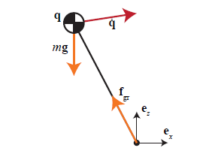

CHAPTER II:
2.4. UNILATERAL CONTACT AND VHIP.
Considering:
$$u=\frac{1}{m}\frac{f_{ground}}{\sqrt{x^{2}+z^{2}}}$$
Forces in x
$$f_{x}=m\ddot{x}→mxu=m\ddot{x}→\ddot{x}=xu$$
Forces in z
$$f_{y}−mg=m\ddot{z}→mzu−mg=m\ddot{z}→\ddot{z}=−g+zu$$
[6] T. Koolen, M. Posa y R. Tedrake

Slide 5
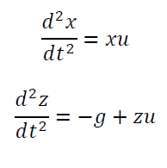
Control of the VHIP

Slide 6



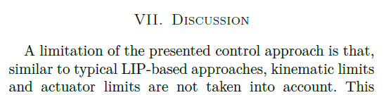
Control of the VHIP
Orbital Energy Control

Slide 7

CHAPTER II:
2.4. UNILATERAL CONTACT AND VHIP:
$$T=−\frac{x}{\dot{x}}$$
$$z_{crit}\left(x\right)=z−\frac{\dot{z}x}{\dot{x}}−\frac{gx^{2}}{2{\dot{x}}^{2}}$$
$$z_{crit}\left(x\right)≤0→\dot{x}\left(x\dot{z}−\dot{x}z\right)≥−\frac{gx^{2}}{2}$$
$$\frac{d}{dt}z_{crit}\left(x\right)=u\frac{x}{\dot{x}}\frac{1}{{\dot{x}}^{2}}\left(gx^{2}+\dot{x}\left(x\dot{z}−\dot{x}z\right)\right)≤0$$
We need: $z_{crit}\left(x\right)>0$
Same way: $T>0$
[6] T. Koolen, M. Posa y R. Tedrake

Slide 8

CHAPTER III:
3.1. PHASE PLANE AND BARRIER FUNCTIONS.
$$\begin{matrix}\ddot{x}=xu \\ \ddot{z}=−g+zu\end{matrix};0≤u≤u_{max}$$
Change of variables:
$u=u_{max}$
$t=\frac{τ}{\sqrt{u_{max}}}$
$z\left(τ\right)=\frac{g}{u_{max}}z_{2}\left(τ\right)=\frac{g}{u_{max}}z_{f}$

Slide 9
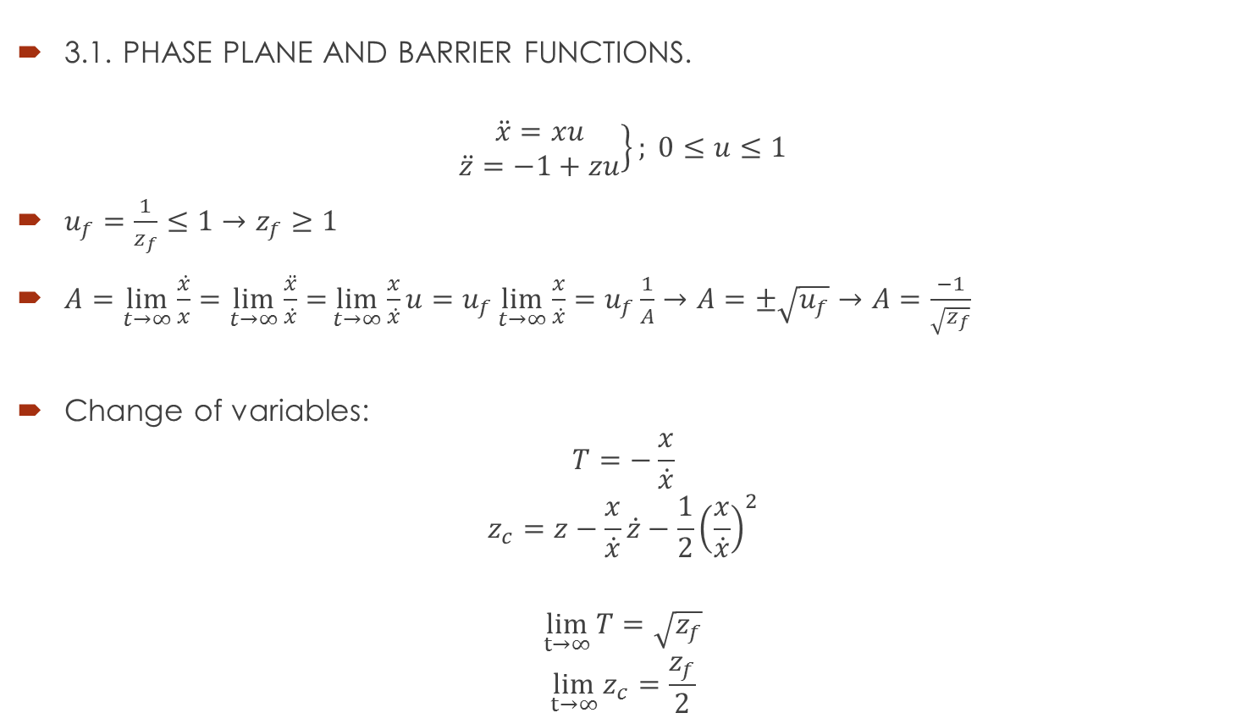
CHAPTER III:
3.1. PHASE PLANE AND BARRIER FUNCTIONS.
$$\left.\begin{matrix}\ddot{x}=xu \\ \ddot{z}=−1+zu\end{matrix}\right\}; 0≤u≤1$$
$u_{f}=\frac{1}{z_{f}}≤1→z_{f}≥1$
$A=\lim_{t→∞}{\frac{\dot{x}}{x}}=\lim_{t→∞}{\frac{\ddot{x}}{\dot{x}}=}\lim_{t→∞}{\frac{x}{\dot{x}}}u=u_{f}\lim_{t→∞}{\frac{x}{\dot{x}}}=u_{f}\frac{1}{A}→A=±\sqrt{u_{f}}→A=\frac{−1}{\sqrt{z_{f}}}$
Change of variables:
$$T=−\frac{x}{\dot{x}}$$
$$z_{c}=z−\frac{x}{\dot{x}}\dot{z}−\frac{1}{2}{\left(\frac{x}{\dot{x}}\right)}^{2}$$
$$\lim_{t→∞}{T}=\sqrt{z_{f}}$$
$$\lim_{t→∞}{z_{c}}=\frac{z_{f}}{2}$$

Slide 10

CHAPTER III:
3.1. PHASE PLANE AND BARRIER FUNCTIONS
$$\dot{T}=−1+T^{2}u$$
$${\dot{z}}_{c}=T\left(z_{c}−\frac{1}{2}T^{2}\right)u$$
$$\dot{x}=−\frac{1}{T}x$$
$$\dot{z}=\frac{1}{T}\left(z_{c}−z+\frac{1}{2}T^{2}\right)$$
Equilibrium points:
$$\left(T,z_{c},x,z\right)=\left(\sqrt{z_{f}},\frac{z_{f}}{2},0,z_{f}\right);u=z_{f}^{−1/2 }, z_{f}∈ℝ$$

Slide 11

CHAPTER III:
3.1. PHASE PLANE AND BARRIER FUNCTIONS.
Let’s define:
$$B\left(z\right)=1−T$$
$X_{0}=\left\{T>1, T∈ℝ\right\}$ y $X_{u}=\left\{0<T<1, T∈ℝ\right\}$
$T_{f}=\sqrt{z_{f}}∈X_{0}$. In $X_{u}$:
$\dot{B}\left(z\right)=1−T^{2}u>1−\max_{T∈X_{u}}{T^{2}}\max{u}=1−1=0→\dot{B}\left(z\right)>0$
$T$ must hold:
$$T>1↔z∈X_{0}$$

Slide 12

CHAPTER III:
3.1. PHASE PLANE AND BARRIER FUNCTIONS.
Same way with $z_{c}$:
$$z_{c}>\frac{1}{2}$$

Slide 13

CHAPTER III:
3.2. ISS OF THE VHIP.
$$\left.\begin{matrix}\dot{x}=−\frac{1}{T}x \\ \dot{z}=\frac{1}{T}\left(z_{c}−z+\frac{1}{2}T^{2}\right)\end{matrix}\right\}$$
$$\left.\begin{matrix}\dot{T}=−1+T^{2}u \\ {\dot{z}}_{c}=T\left(z_{c}−\frac{1}{2}T^{2}\right)u\end{matrix}\right\}$$
$T$ y $z_{c}$ are two “virtual inputs" for the first subsystem:
$$\begin{matrix}T=u_{1}+\sqrt{z_{f}} \\ z_{c}=u_{2}+\frac{z_{f}}{2}\end{matrix}$$
In stability$\left(u_{1},u_{2}\right)→\left(0,0\right)$. Let’s define:
$$u_{p}={\left(u_{1},u_{2}\right)}^{T}$$

Slide 14

CHAPTER III:
3.2. ISS OF THE VHIP.
$$\begin{matrix}\dot{x}=−\frac{1}{u_{1}+\sqrt{z_{f}}}x \\ \dot{z}=−\frac{1}{u_{1}+\sqrt{z_{f}}}z_{e}+\frac{\frac{1}{2}u_{1}^{2}+u_{2}+u_{1}\sqrt{z_{f}}}{u_{1}+\sqrt{z_{f}}}\end{matrix}$$
Considering ${\left\|u_{p}\right\|}_{∞}≤δ$ We can use the following functions:
$V\left(x\right)=\frac{1}{2}{\left\|x\right\|}^{2}=\frac{1}{2}\left(x^{2}+z_{e}^{2}\right)$
$α_{1}\left(\left\|x\right\|\right)=α_{2}\left(\left\|x\right\|\right)=\frac{1}{2}{\left\|x\right\|}^{2}$
$W_{δ}\left(\left\|x\right\|\right)=\frac{{\left\|x\right\|}^{2}}{2(δ+\sqrt{z_{f}})}$
$ρ\left(\left\|u_{p}\right\|\right)={\left\|u_{p}\right\|}^{2}+2\left(\sqrt{z_{f}}+1\right)\left\|u_{p}\right\|$

Slide 15

CHAPTER III:
3.2. ISS OF THE VHIP.
The system:
$$\begin{matrix}\dot{x}=−\frac{1}{u_{1}+\sqrt{z_{f}}}x \\ \dot{z}=−\frac{1}{u_{1}+\sqrt{z_{f}}}z_{e}+\frac{\frac{1}{2}u_{1}^{2}+u_{2}+u_{1}\sqrt{z_{f}}}{u_{1}+\sqrt{z_{f}}}\end{matrix}$$
Is Input-to-State Stable. One implication is:
$$\lim_{t→∞}{u_{p}\left(t\right)}=0→\lim_{t→∞}{x\left(t\right)}=0$$

Slide 16
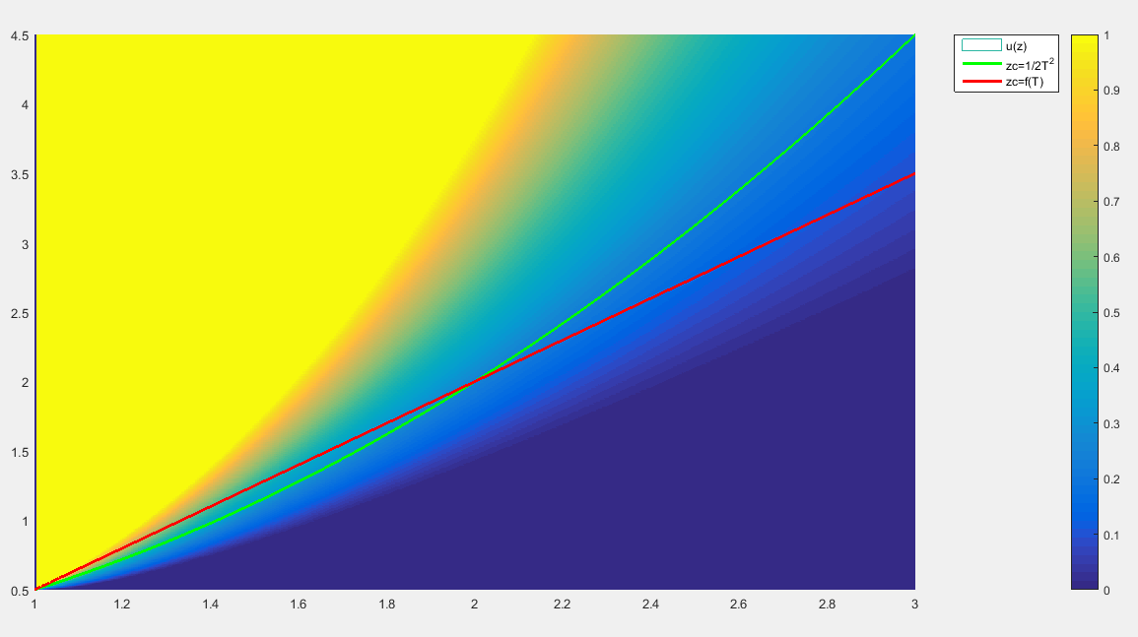


CHAPTER III:
3.3. SLIDING MODE AND VHIP
Sliding surface:
$$z_{c}=f(T)$$
$f$ holds:
$$\begin{aligned}f\left(1\right)=\frac{1}{2} \\ f\left(\sqrt{z_{f}}\right)=\frac{z_{f}}{2}, \\ f\left(T\right)>\frac{1}{2}T^{2}; 1<T<\sqrt{z_{f}} \\ f\left(T\right)<\frac{1}{2}T^{2}; \sqrt{z_{f}}<T\end{aligned}$$

Slide 17

CHAPTER III:
3.3. SLIDING MODE AND VHIP
$$\begin{matrix}\dot{T}=−1+T^{2}u \\ {\dot{z}}_{c}=T\left(z_{c}−\frac{1}{2}T^{2}\right)u\end{matrix};0≤u≤1$$

Slide 18

CHAPTER III:
3.3. SLIDING MODE AND VHIP
$$σ\left(z\right)=\frac{1}{T}\left(z_{c}−f\left(T\right)\right)$$
$$s\left(T\right)=\frac{f\left(T\right)}{T}$$
$$\dot{σ}\left(z\right)=\left(\frac{z_{c}}{T^{2}}+\frac{∂s}{∂T}\right)−uT^{2}\left(\frac{1}{2}+\frac{∂s}{∂T}\right)$$
We need:
$$\dot{σ}\left(z\right)=−k\left(z\right)σ\left(z\right)$$

Slide 19

CHAPTER III:
3.3. SLIDING MODE AND VHIP
$$\dot{σ}\left(z\right)=−k\left(z\right)σ\left(z\right)$$
Feedback:
$$U\left(z\right)=\frac{\left(\frac{z_{c}}{T^{2}}+\frac{∂s}{∂T}\right)+k(z)σ\left(z\right)}{T^{2}\left(\frac{1}{2}+\frac{∂s}{∂T}\right)}$$
$$u\left(z\right)=\max\left(\min\left(U\left(z\right),1\right),0\right)→0≤u\left(z\right)≤1$$
Let’s define:
$$f\left(T\right)=\frac{\sqrt{z_{f}}+1}{2}\left(T−1\right)+\frac{1}{2}→\frac{1}{2}+\frac{∂s}{∂T}>\frac{1}{2}$$

Slide 20
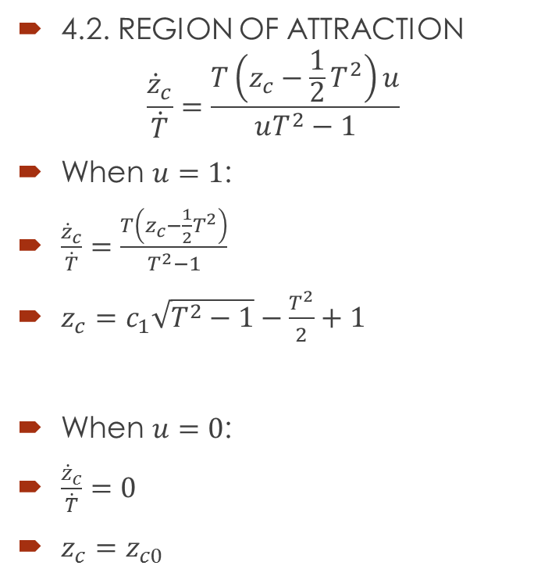
CHAPTER IV:
4.2. REGION OF ATTRACTION
$$\frac{{\dot{z}}_{c}}{\dot{T}}=\frac{T\left(z_{c}−\frac{1}{2}T^{2}\right)u}{uT^{2}−1}$$
When $u=1$:
$\frac{{\dot{z}}_{c}}{\dot{T}}=\frac{T\left(z_{c}−\frac{1}{2}T^{2}\right)}{T^{2}−1}$
$z_{c}=c_{1}\sqrt{T^{2}−1}−\frac{T^{2}}{2}+1$
When $u=0$:
$\frac{{\dot{z}}_{c}}{\dot{T}}=0$
$z_{c}=z_{c0}$

Slide 21
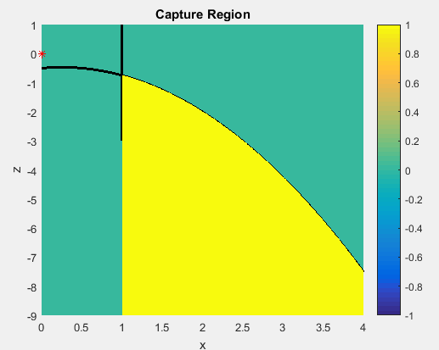


CHAPTER IV:
4.3. CAPTURE REGION.
From$T$:
$$−\frac{x}{\dot{x}}≥1→−x≥\dot{x}$$
From $z_{c}$:
$$z−\frac{x}{\dot{x}}\dot{z}−\frac{1}{2}{\left(\frac{x}{\dot{x}}\right)}^{2}≥\frac{1}{2}→z≥\frac{1}{2}+\frac{\dot{z}}{\dot{x}}x+\frac{1}{2{\dot{x}}^{2}}x^{2}$$
Simetry around (0,0):
$$x_{0}≥\dot{x}$$
$$−\frac{1}{2}+\frac{\dot{z}}{\dot{x}}x_{0}−\frac{1}{2{\dot{x}}^{2}}x_{0}^{2}≥z_{0}$$
CoM in $\left(x,z\right)=\left(0,0\right)$. CR for $\dot{x}=1, \dot{z}=\frac{1}{4}$

Slide 22
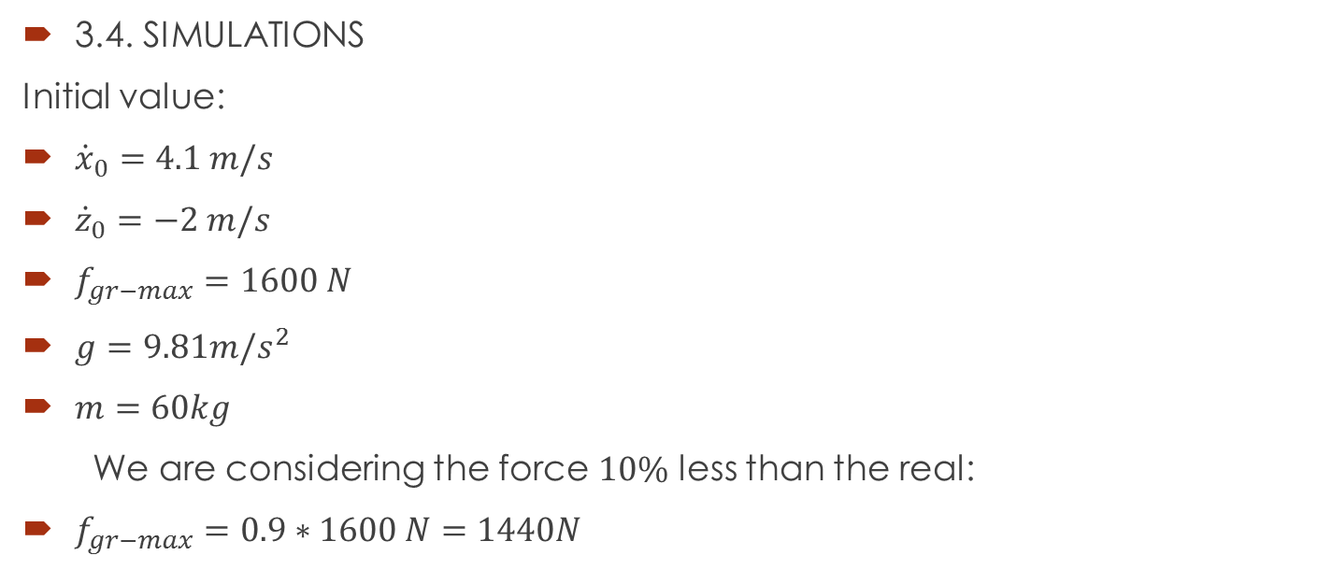
CHAPTER IV:
3.4. SIMULATIONS
Initial value:
${\dot{x}}_{0}=4.1 m/s$
${\dot{z}}_{0}=−2 m/s$
$f_{gr−max}=1600 N$
$g=9.81m/s^{2}$
$m=60kg$
We are considering the force $10\%$ less than the real:
$f_{gr−max}=0.9∗1600 N=1440N$

Slide 23

CHAPTER III:
3.4. SIMULATIONS.
We pick $(1.05,−1.3)m$ as the capture point.
$x_{0}=−1.05 (m)$
$z_{0}=1.3 (m)$
${\dot{x}}_{0}=4.1 m/s$
${\dot{z}}_{0}=−2\frac{m}{s}$
$u_{max}=\frac{f_{gr−max}}{m\sqrt{x_{0}^{2}+z_{0}^{2}}}=\frac{1440N}{60kg∗1.5m}=16 (N/kgm)$
$z_{f0}=1.1 (m)$

Slide 24
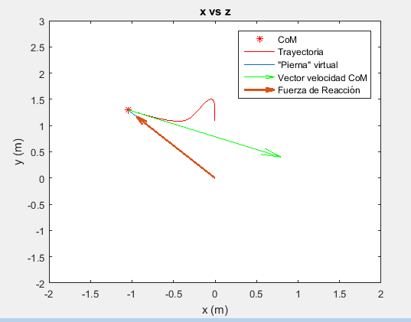

CHAPTER III:
3.4. SIMULATIONS.
Conditions hold:
$T_{0}=1.0244>1$
$z_{c0}=0.7602>\frac{1}{2}$

Slide 25
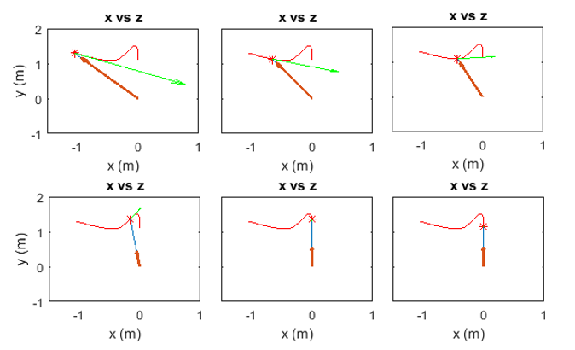
CHAPTER III:
3.4. SIMULATIONS.

Slide 26
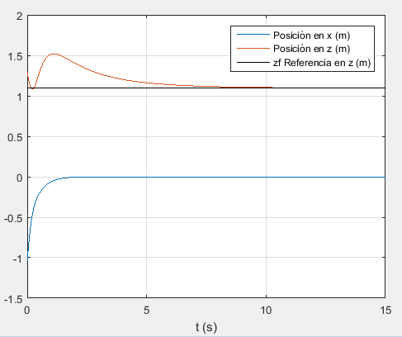
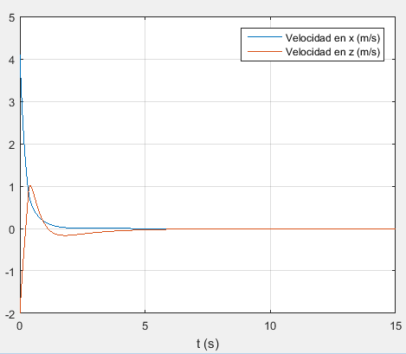
CHAPTER IV:
4.1 SIMULATIONS.

Slide 27
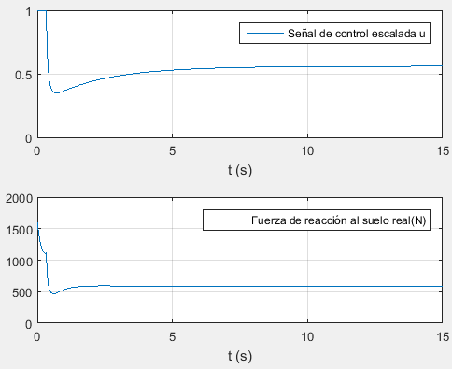
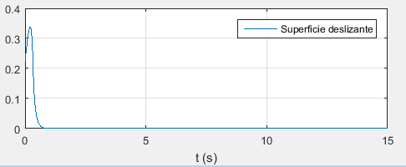
CHAPTER IV:
4.1 SIMULATIONS.

Slide 28
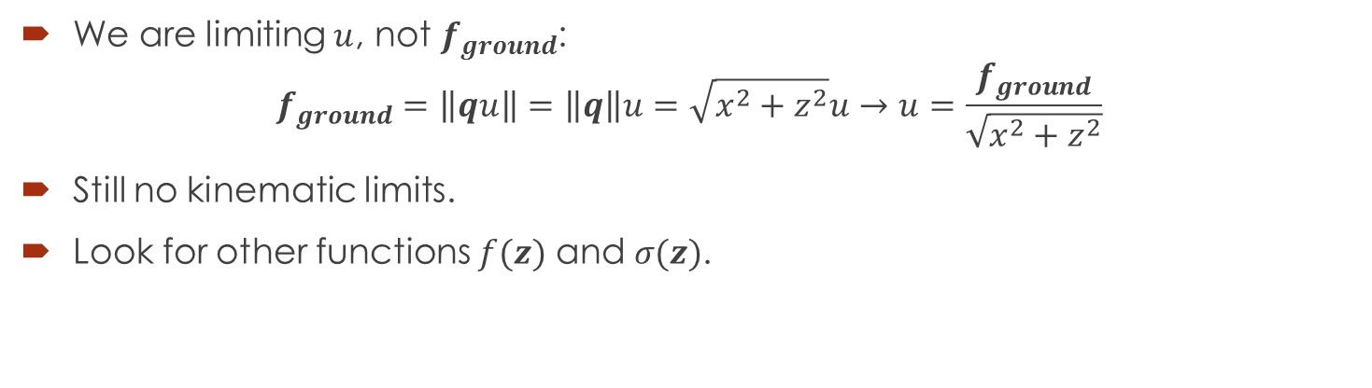
DISCUSSION
We are limiting $u$, not $f_{ground}$:
$$f_{ground}=\left\|qu\right\|=\left\|q\right\|u=\sqrt{x^{2}+z^{2}}u→u=\frac{f_{ground}}{\sqrt{x^{2}+z^{2}}}$$
Still no kinematic limits.
Look for other functions $f(z)$ and $σ(z)$.

Slide 29
REFERENCES
[1] R. Tedrake, «Underactuated Robotics | edX,» [En línea]. Available: https://www.edx.org/es/course/underactuated-robotics-mitx-6-832x-0. [Último acceso: 3 Octubre 2018].
[2] O. E. Ramos y K. Hauser, «Generalizations of the capture point to nonlinear center of mass paths and uneven terrain,» Humanoid Robots (Humanoids), 2015 IEEE-RAS 15th International Conference on, p. 851–858, Nov 2015.
[3] S. Kajita y K. Tani, «Study of dynamic biped locomotion on rugged terrain-derivation and application of the linear inverted pendulum mode.,» Proceeding of IEEE International Conference on Robotics and Automation (ICRA), vol. 2, pp. 1405-1411, 1991.
[4] S. Kajita, K. Tani y A. Kobayashi, «Dynamic Walk Control of a Biped Robot along the Potential Energy Conserving Orbit,» Proceedings of International Workshop on Intelligent Robots and System (IROS '90), pp. 789-794, 1990.
[5] J. E. Pratt y S. V. Drakunov, «Derivation and application of a conserved orbital energy for the inverted pendulum bipedal walking model,» Robotics and Automation, 2007 IEEE International Conference on, p. 4653–4660, Abril 2007.
[6] T. Koolen, M. Posa y R. Tedrake, «Balance control using center of mass height variation: limitations imposed by unilateral contact,» Humanoid Robots (Humanoids), 2016 IEEE-RAS 16th International Conference, pp. 8-15, 2016.

Slide 30
REFERENCES
[7] J. Pratt, J. Carff, S. Drakunov y A. Goswami, «Capture Point: A Step toward Humanoid Push Recovery,» Proceedings of the IEEE-RAS/RSJ International Conference on Humanoid Robots, pp. 200-207, 2006.
[8] S. Caron y A. Kheddar, «Dynamic Walking over Rough Terrains by Nonlinear Predictive Control of the Floating-base Inverted Pendulum,» 2017 IEEE/RSJ International Conference on Intelligent Robots and Systems (IROS), pp. 5017-5024, 2017.
[9] H. K. Khalil, «College of Engineering, Michigan State University,» [En línea]. Available: https://www.egr.msu.edu/~khalil/NonlinearSystems/Sample/Lect_19.pdf. [Último acceso: 02 Octubre 2018].
[10] J.-J. E. SLOTINE, Applied Nonlinear Control, New Jersey, USA: Prentice-Hall, 1991.
[11] S. Fadali, «University of Nevada, Reno - Wolfweb Websites,» University of Nevada, Reno, [En línea]. Available: https://wolfweb.unr.edu/~fadali/EE776/InputStateStab.pdf. [Último acceso: 03 Octubre 2018].

